Slide 1
FARMACI E CHIRURGIA
Trattamento farmacologico per il calo ponderale pre-operatorio
Luca Busetto
Umiversità di padova

Slide 2



Luca Busetto
Dipartimento di Medicina – DIMED
Università degli Studi di Padova
Centro per lo Studio ed il Trattamento Integrato dell’Obesità
Azienda Ospedaliera di Padova
Direttore Scuola di Specializzazione in Scienza dell’Alimentazione
Università degli Studi di Padova
Vice Presidente della European Association for the Study of Obesity (EASO)
Past President della Società Italiana dell’Obesità (SIO)

Slide 3

Luca Busetto
Disclosures: - Advisory Board Member: Novonordisk
Bruno Farmaceutici Pzifer
Eli Lilly
Boehringer Ingelheim
- Speaker: Rythm Pharmaceuticals
  Pronokal

Slide 4
Kushner BS & Eagon JC. Obes Surg. 2021;31:5936

Slide 5
Frutos MD et al. Obes Surg. 2007;17:150

Slide 6
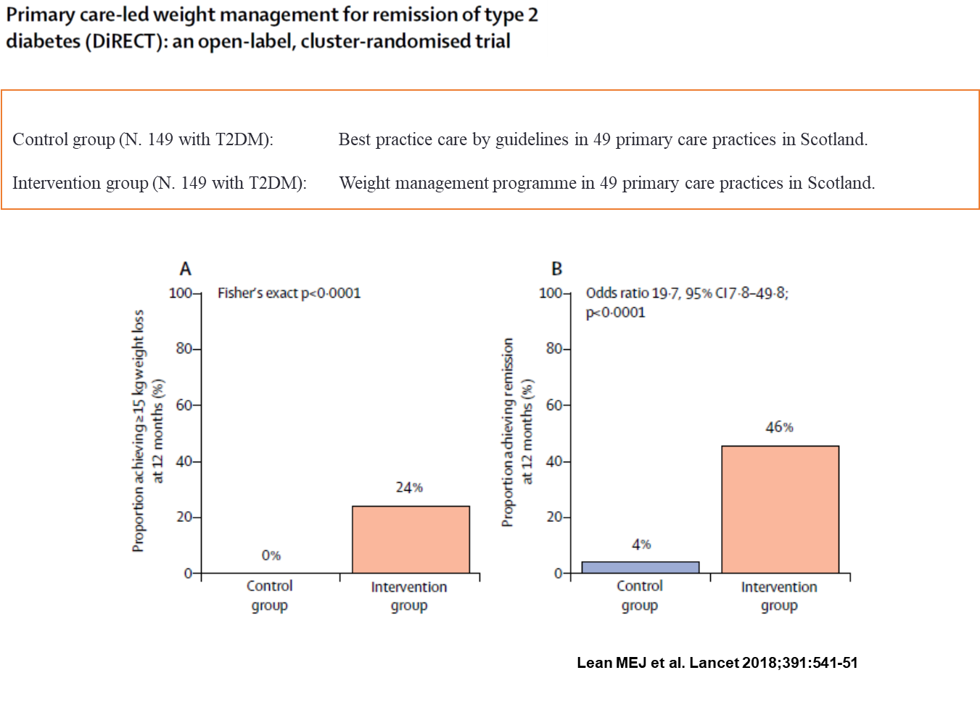

Slide 8
Mechanick JI et al. Surg Obes Relat Dis. 2020;16:175

Slide 9
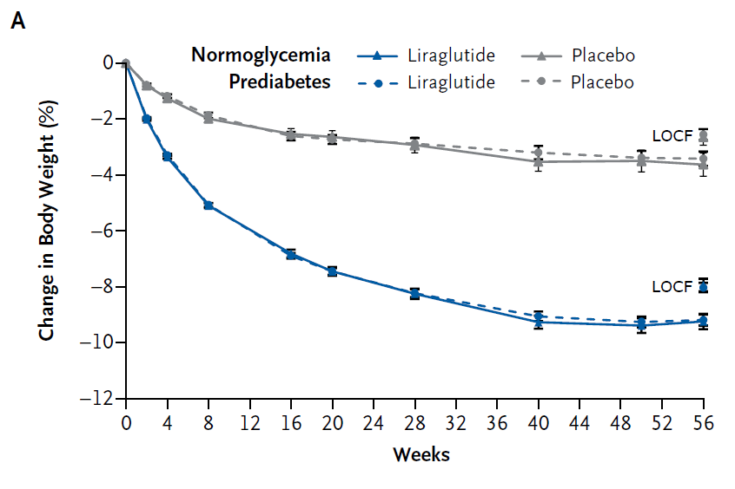
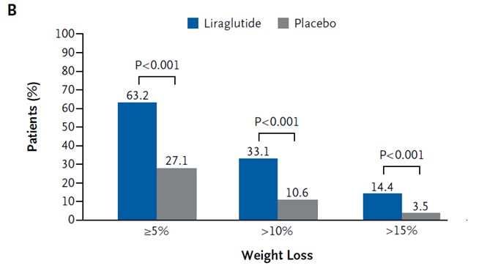
Pi-Sunyer et al. NEJM 2015;373:11

Slide 10
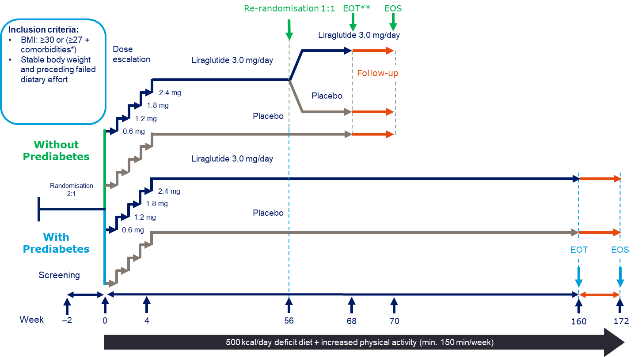
Pi-Sunyer et al. NEJM 2015;373:11

Slide 11
Neeland IJ et al. Lancet Diabetes Endocrinol 2021;9:595.

Slide 12
Davies M et al. JAMA 2015;314:687

Slide 13
Armstrong MJ et al. Lancet 2016;387:679

Slide 14
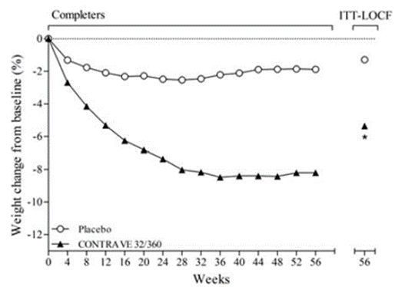
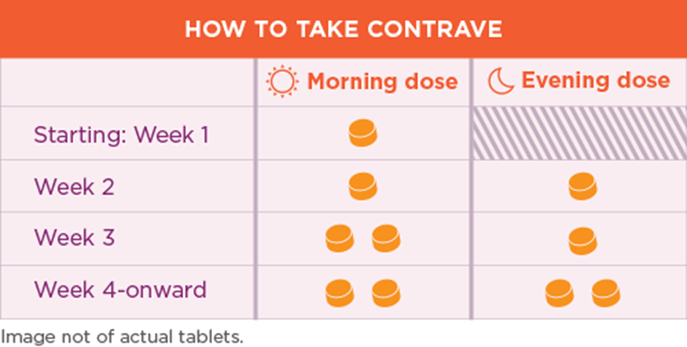

Slide 15
VLCKD AOM
% WEIGHT LOSS 8-10% 8-10%
TIME TO TARGET (m) 1 6-8

Slide 16

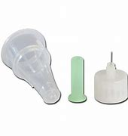

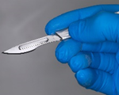
6-8
1
TIME TO SURGERY (months)

Slide 17
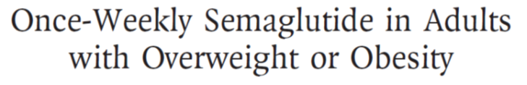
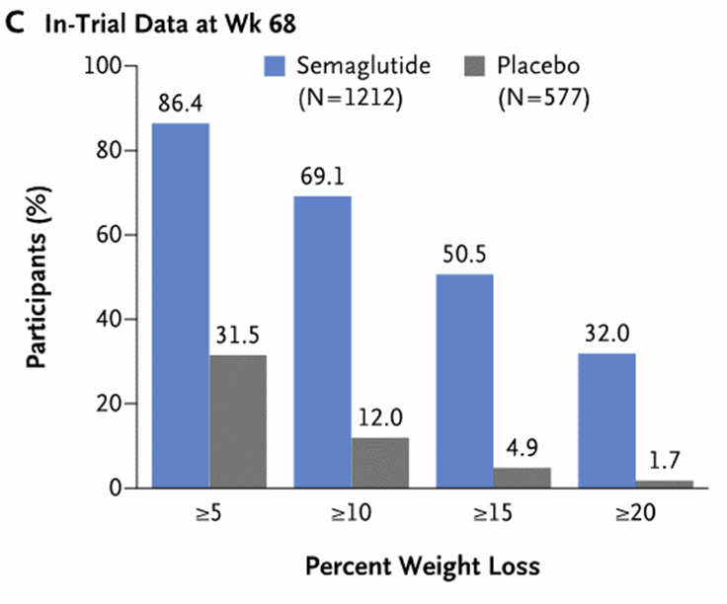
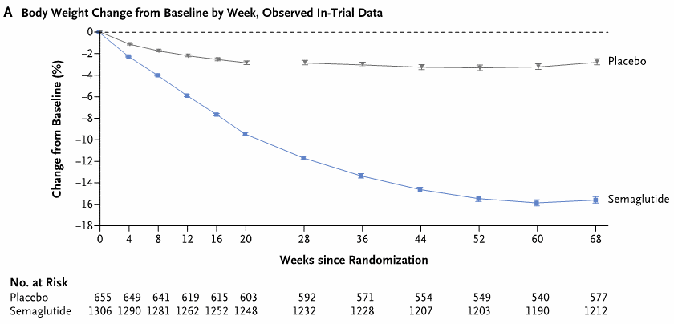


Slide 18
Jastreboff AM et al. N Engl J Med 2022;387:205

Slide 19

Will new pharmacological treatment for obesity and early diabetes replace bariatric surgery?
Lingway I et al. Lancet Diabetes Endocrinol 2023;11:541

Slide 20
A significant proportion of patients do will not achieve the target with obesity management medications
Jastreboff AM et al. N Engl J Med 2022;387:205

Slide 21
A significant proportion of patients do will not achieve the target with bariatric/metabolic surgery
Peterli R et al. JAMA 2018;319:255

Slide 22

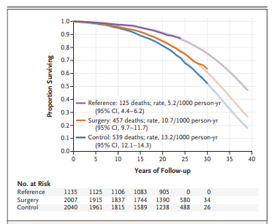
Carlsson LMS et al N Engl J Med 2020;383:1535

Slide 23

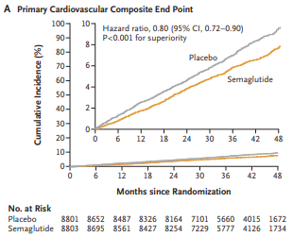
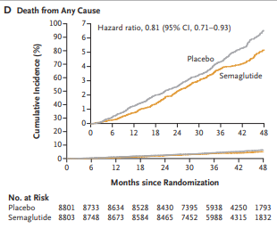
Lincoff AM et al N Engl J Med 2023;389:2221

Slide 24
CLINICAL CASE: FRANCESCO 65 AA
Height 172 cm
Weight 176.0 kg
BMI 59.5 kg/m²
Waist ?????
Heavy smoker
Obesity/Hypoventilation Syndrome with C-PAP (2 previous ICU staying)
CHD
Mild type 2 diabetes

Slide 25
BIB 1
SEMA
SURGERY BLOCKED
BIB 2
ICU
ICU

Slide 26
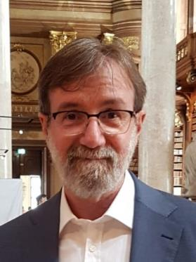



Grazie !!!
Grazie !!!
luca.busetto@unipd.it
Luca Busetto
@busetto_luca

Slide 27


